Slide 1

Zero-Shot Action Recognition in Videos: A Survey
Pooja Patil
San Jose State University
Deep Learning

Slide 2
Introduction
Zero Shot Learning (ZLS)
Aims at recognizing objects from unseen classes.
It is ability of a learner to identify different classes from observed data without never having observed such type of data during the training phase.

Slide 3
Why ZSL
Increasing Demands/requirements for methods that can classify instances from classes that are not present in training samples.
How taxing the process of collecting, annotating, and labeling data for training purposes is.
ZSL, especially for Video Data

Slide 4
Zero Shot Action Recognition
ZSL recognizes an action by its closest estimation to the available data class.
I.e by an error estimation to provide an accurate output.

Slide 5
Constraints and how ZSL overcomes it?
The accuracy of the technique will be limited by the availability of data classes from the training model.
To overcome this constraint ZSL makes use of:
Visual Embedding Labels
Semantic Embedding Labels

Slide 6
Visual Embedding
The ability to understand imagery and convert it into a machine-readable code

Slide 7
Semantic embedding
The model here tries to read words instead of images
Classifies it after comparing it with the available data set

Slide 8
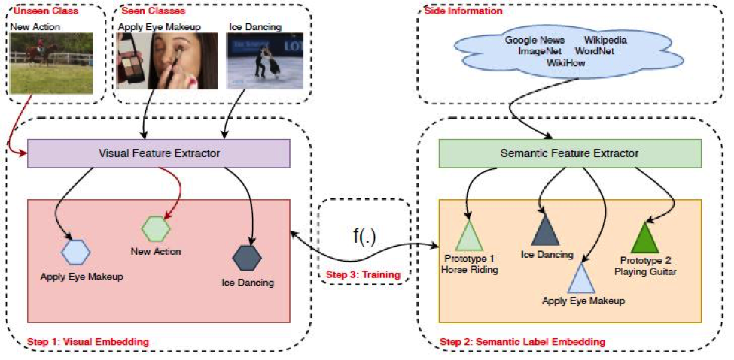
Embeddings
Photo Credit: https://arxiv.org/pdf/1909.06423.pdf

Slide 9
Zero Shot Recognition in Videos
Videos are constrained by Pixel x Pixel x Frames Per Second.
This added dimension adds up to the complexity of the problem.
The mapping function discussed in the picture before is the method is constrained by three attributes:
Efficiency of Visual and Semantic Embeddings.
The Mapping Techniques
The Data sets used

Slide 10
Visual Embeddings continued
Visual Embedding Methods are usually categorized as:
1. Hand Crafted Methods
Bag of features
Dense Trajectory Features
Improved Desnse Trajectories
2. Deep Features Methods
VGG
ResNet-200
3D- CNN
etc

Slide 11
Semantic Embedding continued
Similar analysis can be done for Semantic Embedding:
Attribute
Annotated
Dictionary Learning
Word Embedding
Semantic Hierarchies
Word2Vec
Glove

Slide 12
Mapping Techniques
Attribute-based methods
Word Label Embedding
Semantic Relationships
Objects as Attributes
Multi-Modal Learning
Generative Methods

Slide 13
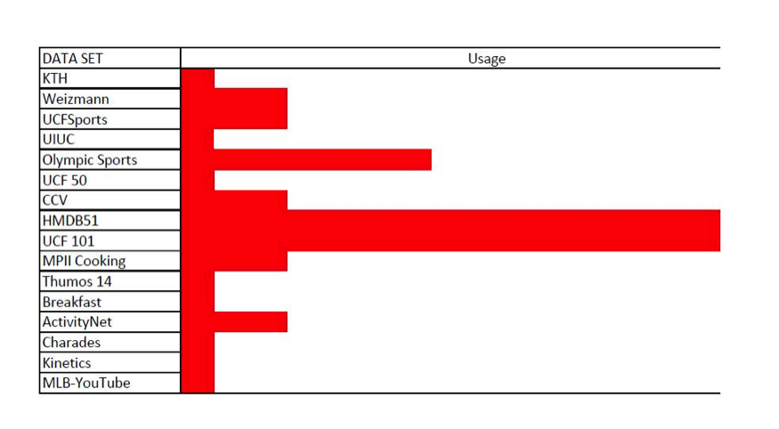
Datasets and General Statistics of their usage

Slide 14
Conclusion
We presented ZSL methods for action recognition in videos such as visual and semantic extraction.
Several methods/mapping techniques
Also a few datasets and general statistics for their usage.

